Slide 1

DEPARTMENT OF ARTIFICAL INTELLIGENCE AND DATA SCIENCE
6th Sem Project Phase-1
“A Hybrid Neural Network for EEG-based Depression Screening Using CNN”
Project Team Members
Name USN
B.LATHA SREE 1SJ22AD006
C S MOUNIKA 1SJ22AD008
M.CHARAN 1SJ22AD024
Project Guide
Badrinath K
Assistant Professor

Slide 2

A Hybrid Neural Network for EEG-based Depression Screening Using CNN
TABLE OF CONTENTS
  Problem Statement
  Purpose, Scope, Objectives
  Abstract
  Introduction
  Literature Survey
  Methodology
  Algorithms
  Modules Split-up
  Proposed system
  Software Specification Requirements
  Expected Outcomes
  References
  Project Plan 2.0

Slide 3
A Hybrid Neural Network for EEG-based Depression Screening Using CNN
ABSTRACT
Depression is a widespread psychological disorder affecting people of all ages. Early diagnosis is crucial, and EEG signals can help assess mental health. This project proposes a fully automated Depression Detection System using a novel Hybrid Neural Network, DepHNN, which combines CNN for temporal learning and LSTM for sequence learning. EEG data from 21 depressed and 24 normal drug-free individuals were used. The system achieves 99.10% accuracy and a MAE of 0.2040, offering an efficient, accurate, and low-complexity solution for EEG-based depression screening.

Slide 4
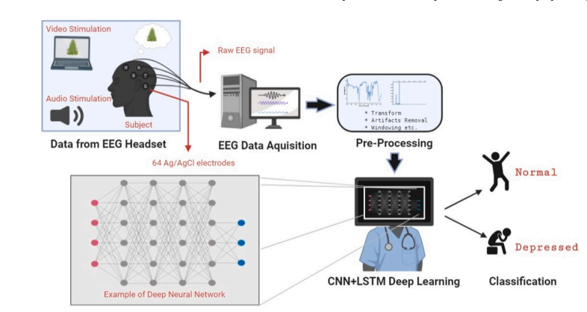
A Hybrid Neural Network for EEG-based Depression Screening Using CNN
INTRODUCTION
Depression affects over 322 million people worldwide, with a higher incidence among females. Although it is a treatable condition, nearly half of the cases remain undiagnosed due to factors like limited awareness, insufficient resources, and incorrect diagnoses. EEG signals, being non-invasive and cost-effective, serve as valuable biomarkers for identifying neurological disorders, including depression. However, their complexity makes manual analysis challenging. To address this, the project proposes a hybrid LSTM-CNN model (DepHNN) for efficient and accurate detection of depression using EEG data.

Slide 5
A Hybrid Neural Network for EEG-based Depression Screening Using CNN
PROBLEM STATEMENT
Depression is a major mental health issue affecting over 322 million people worldwide, contributing to significant emotional, social, and economic burdens. Traditional methods for diagnosing depression, such as clinical interviews and self-reported questionnaires, are subjective and time-consuming. EEG-based diagnosis provides objective insights into brain activity but is prone to human error due to the complexity of interpreting EEG signals. Thus, there is a critical need for an automated and accurate depression screening system using EEG signals.

Slide 6
A Hybrid Neural Network for EEG-based Depression Screening Using CNN
PURPOSE
A fully automated, intelligent screening system is proposed for detecting depression using electroencephalogram (EEG) signals. By leveraging a hybrid deep learning architecture that combines Convolutional Neural Networks (CNN) and Long Short-Term Memory (LSTM) networks, the system enhances diagnostic accuracy while minimizing human intervention and computational overhead.

Slide 7
A Hybrid Neural Network for EEG-based Depression Screening Using CNN
SCOPE
The system focuses on the development of a deep learning-based diagnostic tool that utilizes EEG signals for the automated identification of depressive disorders. It covers the entire pipeline—from signal acquisition and preprocessing to model training, evaluation, and integration into a deployable framework suitable for clinical environments or mental health screening platforms.

Slide 8
EXISTING SYSTEM
Earlier EEG-based depression detection systems used manual feature extraction with classifiers like SVM and PNN, achieving up to 98% accuracy but were time-consuming. Deep learning models like CNN (93.5%) and CNN-LSTM (97.66%) automated feature learning. The proposed DepHNN combines CNN and LSTM to learn both temporal and sequential EEG patterns. Using techniques like ReLU, softmax, windowing, and Adam optimizer, it achieved 99.1% accuracy with low computational complexity.

Slide 9
A Hybrid Neural Network for EEG-based Depression Screening Using CNN
LITERATURE SURVEY
Author(s) | Research Paper Title | Advantages | Disadvantages | Implementation in Project
A. Seal | DeprNet: A Deep Convolution Neural Network Framework for Detecting Depression Using EEG | High accuracy with CNNs; Effective feature extraction | High model complexity; requires large training data | CNN-based feature extraction in DepHNN
Z. Wan | HybridEEGNet: A Convolutional Neural Network for EEG Feature Learning and Depression Discrimination | CNN efficiently learns complex EEG features; Good generalization | Needs optimization for small datasets | Supports the hybrid model concept (CNN + sequence learning)
S. Sun | EEG-Based Depression Recognition by Combining Functional Brain Network and Traditional Biomarkers | Enhances detection with connectivity features | Moderate performance; complex preprocessing needed | Highlights combination of local and global feature learning
A. Sekhar | Performance Evaluation of LSTM Models in Detection of Depression from EEG Signals | LSTM captures sequential dependencies effectively | Needs careful tuning; high computational load | Justifies the use of LSTM layers in DepHNN

Slide 10

A Hybrid Neural Network for EEG-based Depression Screening Using CNN
PROPOSED SYSTEM
Objective: Early and accurate detection of depression using EEG signals.
System: Fully automated Computer-Aided Diagnosis (CAD) system using deep learning.
Innovation: Combines CNN for temporal feature extraction and LSTM for sequence learning.
Input: EEG signals from normal and depressed subjects.

Slide 11
A Hybrid Neural Network for EEG-based Depression Screening Using CNN
OBJECTIVES
Design a CNN-LSTM model to automate depression detection using EEG signals.
Improve adaptability using cross-validation and diverse datasets while employing regularization techniques like L2 regularization and adaptive learning rates.
Enhance model accuracy and generalization through techniques such as dropout, data augmentation, and early stopping.
Reduce computational complexity and latency for real-time depression screening on portable and cloud-based platforms.

Slide 12
A Hybrid Neural Network for EEG-based Depression Screening Using CNN
SOFTWARE SPECIFICATION REQUIREMENTS
SI.NO | Software Requirements | Hardware Requirements
1. | Programming Language : Python | Processor: Intel Core i7 (2.3 GHz)
2. | Development Environment : Jupyter Notebook, Google Colab | RAM: 12 GB DDR4
3. | Deep Learning Frameworks: Keras, TensorFlow | GPU: Google Colab GPU / NVIDIA CUDA-enabled GPU
4. | Scientific & Data Libraries: NumPy, Pandas, SciPy, Scikit-learn. | EEG Device Used: Neuroscan EEG System
5. | Visualization Tools: Matplotlib, Seaborn

Slide 13

A Hybrid Neural Network for EEG-based Depression Screening Using CNN
METHODOLOGY
CNN (Convolutional Neural Network)
  CNN is highly effective at capturing spatial patterns in data. In EEG signals, it helps identify local temporal features (like specific waveforms or frequency patterns) from raw or preprocessed signal inputs.
ReLU (Rectified Linear Unit)
f(x)=max(0,x)
which means it outputs x if x > 0, else 0.
Softmax

Slide 14
A Hybrid Neural Network for EEG-based Depression Screening Using CNN
ALGORITHMS
Hybrid Model: CNN + LSTM (DepHNN)
CNN Role:
Temporal feature extraction, Windowing to reduce complexity
LSTM Role:
Sequence learning, Captures long-term dependencies in EEG data
Final Layers: Fully connected + Softmax for classification

Slide 15
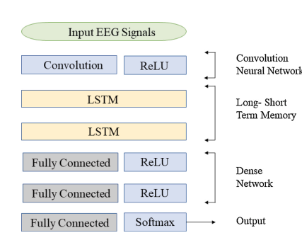
A Hybrid Neural Network for EEG-based Depression Screening Using CNN
DESIGN

Slide 16
.
A Hybrid Neural Network for EEG-based Depression Screening Using CNN
MODULES SPLIT-UP
LIST OF MODULES
ReLU (Rectified Linear Unit)
LSTM (Long Short-Term Memory)
Softmax
Module 1:ReLU (Rectified Linear Unit)
ReLU is an activation function used in neural networks.
Purpose in the Model:
Adds non-linearity to the model.
Allows the neural network to learn complex features.
Speeds up convergence compared to sigmoid/tanh.

Slide 17
.
A Hybrid Neural Network for EEG-based Depression Screening Using CNN
Module 2:LSTM (Long Short-Term Memory)
LSTM is a type of Recurrent Neural Network (RNN) designed to model time-series or sequential data by remembering long-term patterns.
It uses internal memory (called cells) and gates to regulate the flow of information.
Purpose in the Model:
Remembers important patterns over multiple time steps.
Helps understand temporal dependencies in EEG signals.
Improves performance on sequence data like brainwave activity.
Avoids vanishing gradient problems found in traditional RNNs.

Slide 18
A Hybrid Neural Network for EEG-based Depression Screening Using CNN
Module 3: Softmax
Softmax is an activation function used in the output layer of a neural network for classification tasks.
It converts raw scores (logits) into probabilities, so that the sum of all output values equals 1
Purpose in the Model:
Converts the model’s raw output into interpretable probabilities.
Helps the model make a clear decision about which class (e.g., depressed / not depressed) the input belongs to.
Ensures the output is a probability distribution.

Slide 19
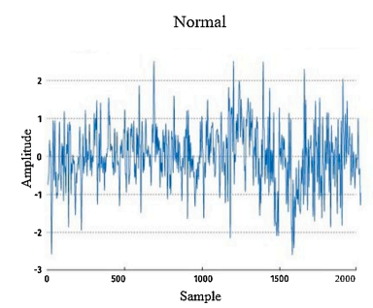
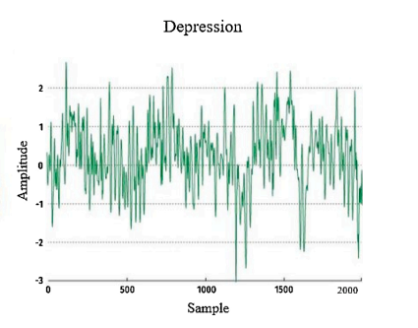
A Hybrid Neural Network for EEG-based Depression Screening Using CNN
EXPECTED OUTCOMES
Accuracy: 99.1%
Mean Absolute Error(MAE): 0.204
Efficiency: Faster training time (112s/epoch)
Model Strength:
Low complexity
High accuracy
Real-time clinical applicability

Slide 20
A Hybrid Neural Network for EEG-based Depression Screening Using CNN
REFERENCES
Automated EEG-based screening of depression using deep convolutional neural network, U. R. Acharya, H. Fujita, S. L. Oh, Y. Hagiwara, J. H. Tan, and M. Adam
https://doi.org/10.1016/j.compbiomed.2018.06.008
Deep convolutional neural network model for automated diagnosis of depression using EEG signals, S. L. Oh, U. R. Acharya, Y. Hagiwara, J. H. Tan, and H. Adeli
https://doi.org/10.3390/app9153319
Implementation guides for CNN and LSTM using Keras’ Sequential API.
https://keras.io/guides/sequential_model/
TensorFlow, https://www.tensorflow.org/api_docs
Scikit-learn, https://scikit-learn.org/stable/modules/generated/sklearn.preprocessing.StandardScaler.html
Huber Loss – TensorFlow API, https://www.tensorflow.org/api_docs/python/tf/keras/losses/Huber

Slide 21
A Hybrid Neural Network for EEG-based Depression Screening Using CNN
PROJECT PLAN 2.0
Frontend & UI: Design simple web interface for EEG data upload & result display.
Backend API & Model Serving: Deploy model with Flask/FastAPI and connect to frontend.
Real-Time EEG Integration: Connect with EEG hardware or simulated input for live predictions.
Cloud Deployment: Host app on Render/AWS/Vercel with full-stack integration.
Testing & Final Report: Run test cases, document performance, and finalize project report.

Slide 22


